Slide 1



Stack Overflow Questions Forecasting: Python Trends
Presented by: Ritik Kumar
Course: Business Forecasting
Instructor: Professor Ronak R. Parikh
Date:11/25/2024

Slide 2

Introduction
Content:
Objective: Analyze and forecast trends in Python-related questions on Stack Overflow.
Importance: Python is a dominant programming language widely used in AI, data science, and development. Forecasting these trends aids in resource optimization and strategic planning.

Slide 3
Project analysis slide 2
Project Analysis
Exploratory Data Analysis
(EDA)
Forecasting Objectives
Stack Overflow Analysis
Forecast Results
Model Selection
Residual Analysis
Model Training & Testing

Slide 4

Dataset Description
Content:
Source: Stack Overflow dataset (2008–2024).
Key Features:
Month: Date
(MM-DD-YYYY).
Python: Monthly count of Python-related questions.
Preprocessing:
Converted Month to Date format.
Focused on Python data.

Slide 5

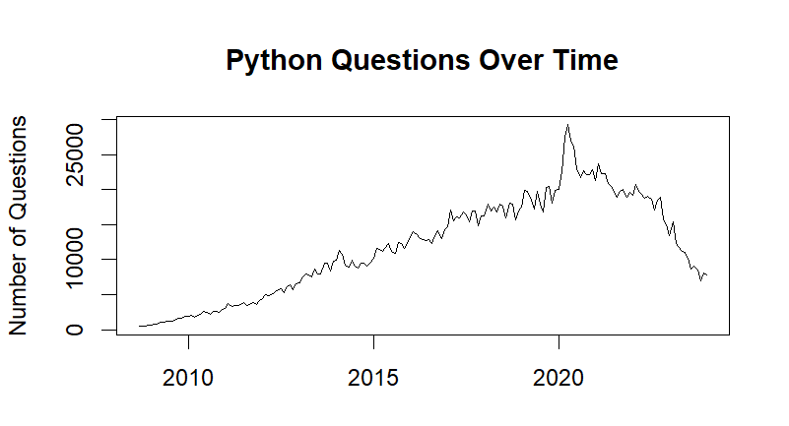
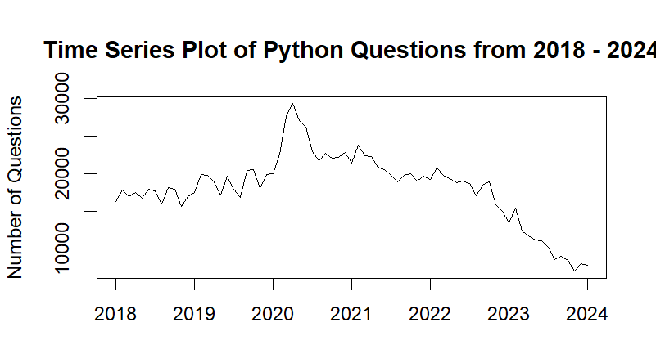
Exploratory Data Analysis
Trends Observed:
Growth in Python-related questions until 2021.
Decline from 2021 to 2024.
Visualizations:
Time series plots showcasing trends (2008–2024 and 2018–2024).

Slide 6

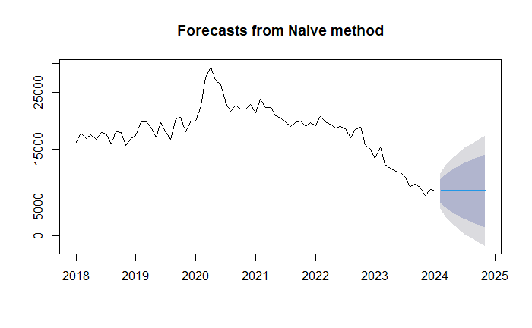
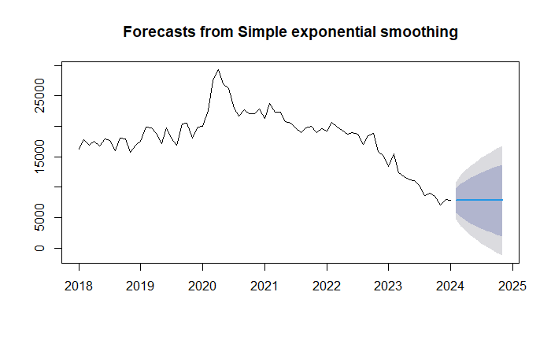
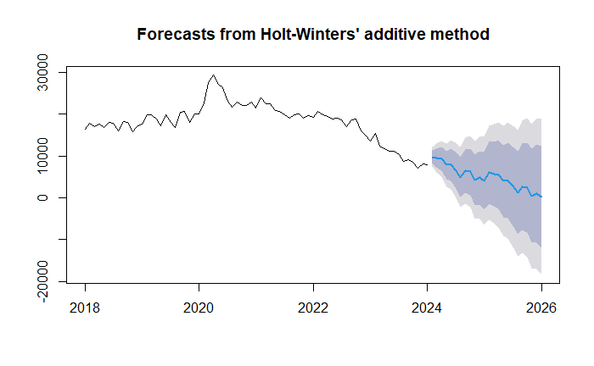
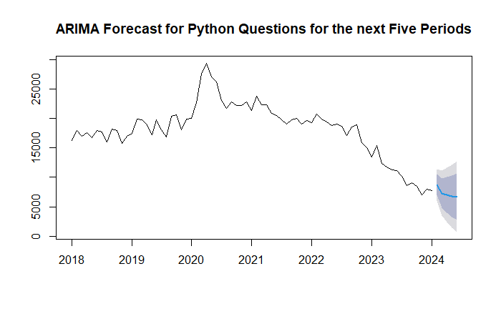
Forecasting Methods
Models Used:
NAÏVE: Baseline model.
ETS: Decomposes data into error, trend, and seasonality.
Holt-Winters: Handles trend and seasonality with dampening.
ARIMA: Combines autoregression, differencing, and moving averages.

Slide 7

Accuracy Measures
Metrics Used:
ME, RMSE, MAE, MPE, MAPE, MASE, ACF1.
Importance:
RMSE and MAE indicate error magnitude.
MAPE provides a percentage-based error.
MASE validates model performance against a naive baseline.

Slide 8
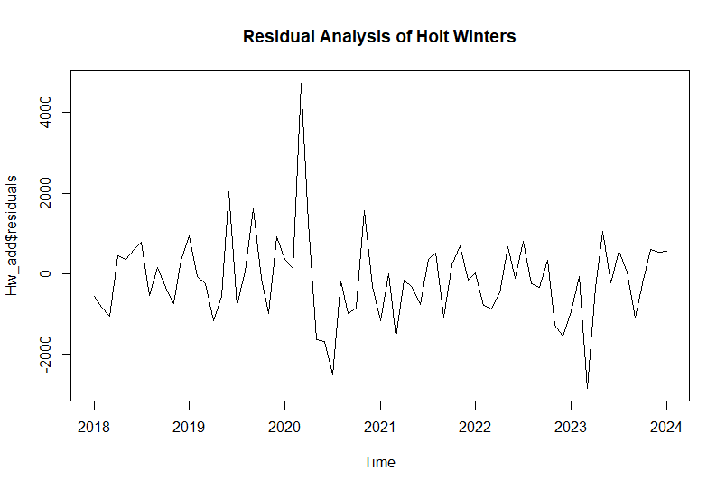
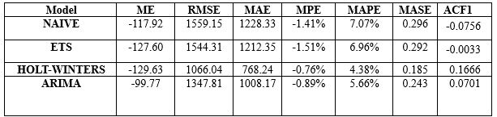
Forecast Results
Predicted Trends:
Stabilization or slight decline in Python-related questions post-2024.
Chosen Model:
Holt-Winters: Best performance with the lowest RMSE and MAPE.

Slide 9

Decision Based on Analysis
Interpretation:
Python-related questions are stabilizing, indicating market saturation.
Implications:
Businesses: Plan resources around plateauing Python trends.
Educators: Diversify curriculum to include emerging technologies.

Slide 10

Recommendations and Future Work
Recommendations:
Optimize resources during peak Python activity.
Explore other emerging programming languages.
Future Work:
Include additional features (e.g., job market trends, demographics).
Test advanced machine learning models (e.g., LSTM, XGBoost).

Slide 11
Thank You
Questions or Feedback?
Email: rk1208@scarletmail.rutgers.edu

